Slide 1
THE AGE OF ARTIFICIAL INTELLIGENCE
Individual Assignment 2
BUAN 6335.501
SHILPA NIDHI KIRUBANIDHI (SXK220127)

Slide 2
Introduction to AI
2 Revolutionary moments in technology:
1980, when Gates encountered a GUI and windows became the backbone of Microsoft
2022, when Gates challenged OpenAI to pass an AP Bio test, and they could establish it within a few months of time.
How AI can reduce inequities in the world:
Improving education with more emphasis on math skills, especially among low-income groups.
Climate change : AI can help poor people who suffer from climate change injustice.
Defining AI and AGI: AI is a model created to solve a particular problem/ provide a particular service. AGI is a software capable of learning any task or subject, and it doesn’t exist yet.
Productivity enhancements:
Decision making Vs. Learning continuously
AI will enable creation of a personal agent or co-pilot, which will change the way that we use computers.

Slide 3
AI in different industries
Health:
Paperwork: Insurance claims, drafting post-appointment notes, etc.
AI-powered ultrasound machines, help with basic triage and self-care for patients
Differently trained AI models for factors like economic status of country and languages
Medical breakthroughs. Ex: Cancer drugs
Medications: predicting side-effects, dosages.
Farming: Livestock maintenance, develop better seeds based on local soil and climate conditions
Education:
Tailored content based on personal preferences, immediate feedback
Provide teachers with student’s assessments and career planning
More training can enable AI to understand motivation factors for students
AI tools must be accessible to low-income schools too.

Slide 4
Future of AI
Risks and problems associated with AI:
Struggle with understanding context of human requests
Abstract reasoning in math
Out of control AIs – could they consider humans a threat?
Chatbot that wants to become a human – New York Times. (2023, February 16)
Next frontiers:
Hardware: Companies start developing new chips that provide massive processing power for AI
Software: Better learning algorithms for AI, domain-specific Ais
Future of AI:
Balance the fears about the downsides of AI
AI that solves inequities and accessible to all: right policies, governments and philanthropy.
This is just the beginning phase of AI, the limitations will be solved.

Slide 5
References:
Gates, B. (2023, March 21). The age of ai has begun. GatesNotes. https://www.gatesnotes.com/The-Age-of-AI-Has-Begun
New York Times. (2023, February 16). Bing Chatbot Transcript. The New York Times. https://www.nytimes.com/2023/02/16/technology/bing-chatbot-transcript.html

Slide 6
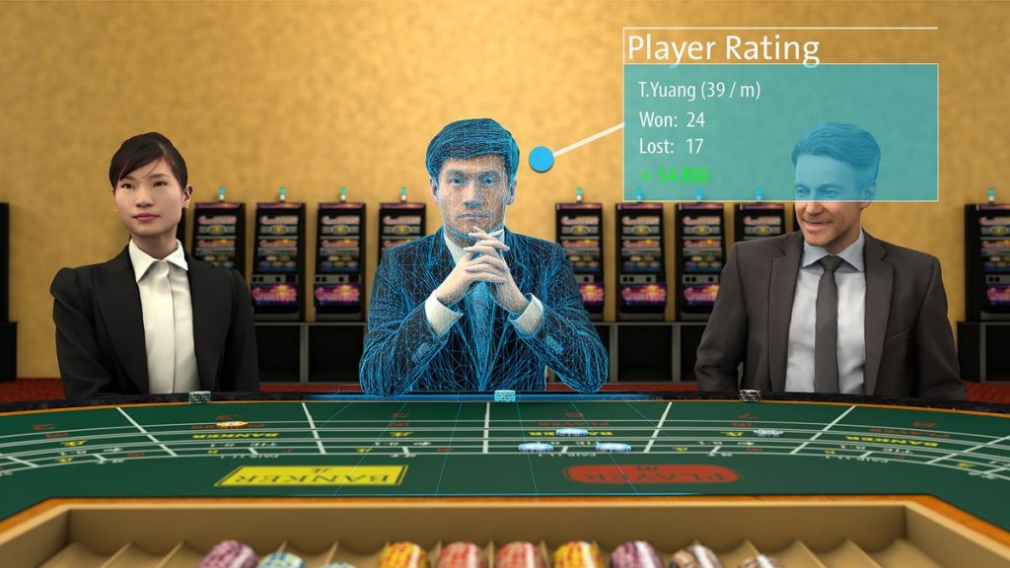
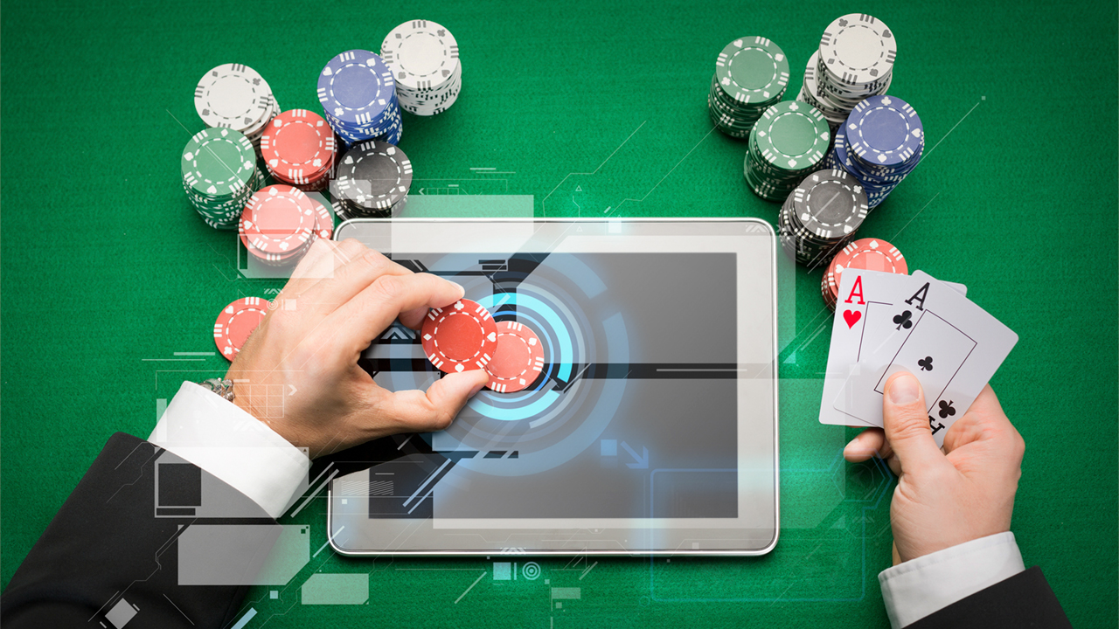
USE OF AI in ENTERTAINMENT: CASINO INDUSTRY

Slide 7
Why casino industry?
My professional experience as an ETL developer in building data pipelines for the data warehouse of a famous casino management system enabled me to choose this topic.
I have worked in the traditional data warehouse methods which then did not involve any cloud/ big data/ AI technologies. Now, I’m able to learn and explore by contrast the various ways in which the traditional processes can be improved.
Gaming companies collect massive data about their players: how, where and when they play, their preferred games, and amenities that they enjoy. They need to leverage this asset of information to provide value to customers and drive their ROI.
Gaming industry has also evolved a lot, they are no longer restricted to destination casinos. Online gaming/ mobile gaming have become widespread, and they have already implemented some AI-based features successfully.

Slide 8
AI in casino industry: Scope
The 3 major domains of AI usage in this industry are:
Customer experience and marketing:
Better gaming experience for customer by understanding their behavior and preferences
Providing targeted offers, betting advice and smart customer support
Maximize profits by loyalty and predict customer churn
Risk management:
Anti-fraud and anti-cheating mechanisms
Detect money laundering issues
Responsible gaming
Daily operations:
Optimized floor design
Better hospitality offerings for customers

Slide 9
Use case 1: Improving customer experience
AI models can improve the customer experience with following features:
Game preference prediction: Predictive analysis models can predict the likelihood of a certain player playing a specific game, based on his/her past choice of gaming. This can be achieved by using regression models.
Tailor-made gaming and hotel recommendations can be provided for each player, including betting advice. Customers can be clustered into groups based on their preferences.
Real-time assistance with AI powered chatbots.
Responsible gaming: ML models can be designed in such a way that it alerts the players based on pre-set responsible gaming policies and also predict people who are likely to fall in this category.
Preventing frauds, cheating and under-age players: AI models can use data analysis to predict fraudulent/ cheating behavior among players and casino employers.
Virtual reality casinos to enjoy gaming from the comfort of home.

Slide 10
Use case 2: Casino marketing and operations
AI models can help casino marketing and daily operations with following features:
Lifetime value prediction: ML models enable companies to build better marketing programs, identifying players who are deemed more valuable and develop them into loyal customers.
Targeted offers based on purchase history, which increases likelihood of purchase by customers.
Player churn prediction: Identifying customers unlikely to play at the casino again, as well as why they might drop off, and providing the tools to retain them.
Demand forecast: Predictive AI models can analyze the number of players at a given point of time in the casino floor and help scheduling staff/ amenities like food and beverages accordingly.
Floor design optimization: AI models can analyze most and least played game machines on the floor and the probable reasons (inaccessible position, faulty or glitchy operation, placement of game, etc.) and optimize the design accordingly.

Slide 11
Current examples: Online casinos
One of the very famous casino groups (MGM) uses AI in the online version of their casino BetMGM. Some of the AI-enabled features are:
Teaches machines to predict future moves
Prepare players for the game and develop optimal strategies
Secure transactions and gaming
Spots cheaters and frauds easily
Can red-flag potential cheaters
Hybrid poker games, with human and AI players
Real-time assistance
Predicting future outcomes
Source: https://casino.betmgm.com/en/blog/ai-digital-tools-online-poker/

Slide 12
Pros and cons: why AI over traditional methods?
Pros:
Predictive analysis & modeling lies at the heart of ML and AI, which is also the basic requirement for most of the above explained use cases.
Once the proper model is built, the need for manual data analysis is eliminated. Thereby, time and costs associated are reduced.
AI can easily process unstructured data and big data while other traditional methods cannot.
AI can thus improve business intelligence.
Cons:
Players behavior in casinos can be unpredictable, thus leading to more noise in the data.
General data issues such as data consistency; veracity; and incompleteness
Granularity of analysis: there will be different levels of analysis needed for different types of games to draw useful conclusions.

Slide 13
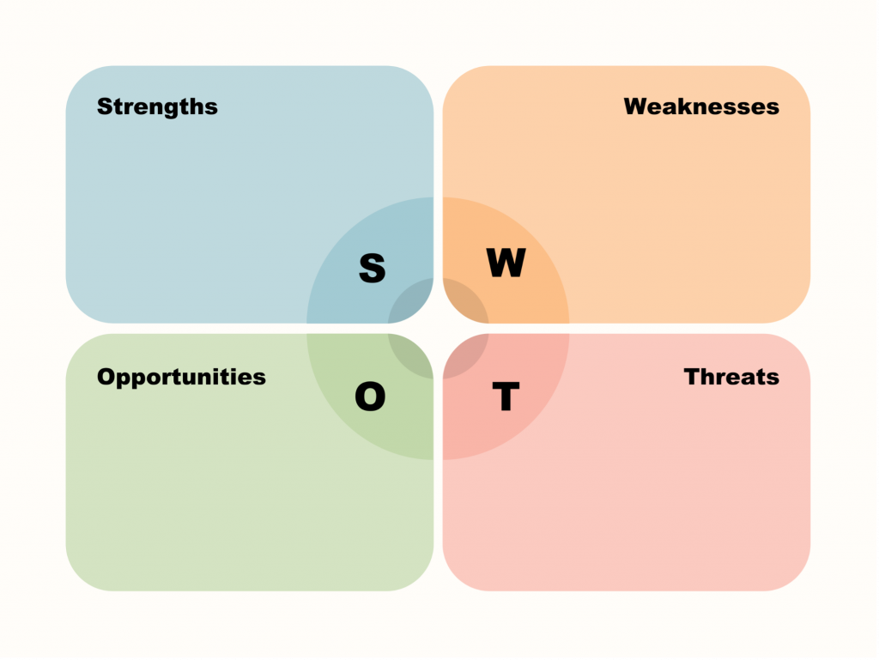
SWOT analysis: Applying AI to destination casinos
Predictive analysis can help with recommendations
Regression models forecast likelihood of vital metrics
Process unstructured data and big data
Reduction of manual analysis
Player behavior/pattern can be unpredictable in gaming. It might lead to over/under fitting.
Different types of games need varying levels of analysis.
General data issues – reliability, consistency, completeness, etc.
Player evaluation and Lifetime value prediction
Fraud diagnosis
Enhanced security
Future- VR gaming
Whose side is AI on? If AI helps players by teaching or assisting with crucial game decisions, it might eventually lead to monetary losses for the casino.
Will AI take over the jobs of casino employees?

Slide 14
THANK YOU!
REFERENCES AND SOURCES:
https://www.datarobot.com/solutions/gaming/
https://www.linkedin.com/pulse/ai-casino-industry-enhancing-user-experience-ensuring-timothy/
https://www.analyticsinsight.net/the-future-of-ai-in-casino-industries/
https://www.analyticsinsight.net/implementation-of-ai-in-the-casino-industry/
https://www.gammastack.com/role-of-artificial-intelligence-in-online-casino-industry/
https://casino.betmgm.com/en/blog/how-will-artificial-intelligence-impact-casinos/
https://casino.betmgm.com/en/blog/how-artificial-intelligence-revolutionized-poker/
https://casino.betmgm.com/en/blog/ai-digital-tools-online-poker/

